Slide 1

Leading People Who Are
Too Busy
Webinar
Pastor’s Coach
Pastorscoach.com © 2025 Quintessant

Slide 2

Agenda
Leading People Who Are TOO BUSY
Intro
Kingdom Priorities: Lordship of Jesus, Resetting Priorities
Kingdom Motivation: Development Based on Design and Destiny
Kingdom Lifestyle: Balance and Discipline
Q&A
Next Steps: The Pastor’s Boot Camp

Slide 3
Intro
Practical training for pastors and leaders
Glen Reed intro.
Focus on health that leads to growth
This is for pastors, leaders and disciplemakers.
We’ll teach for 45 min, then do Q&A, then look at the Boot Camp.
Chat window for questions, or unmute yourself.
We will share things you can use right away; realize we have much more.
We will send you these slides.

Slide 4
Michael Brodeur
Founder of Pastor’s Coach and Destiny Finder
Author of Revival Culture with Banning Liebscher
Born in SF, saved as a hippie, discipled by Pentecostal Blackfeet Indians
Discipled by John Wimber in early Vineyard days.
Planted SF church in the 80s.
Planted new churches, overseer for 25+ churches.
Created Destiny Finder
Started coaching pastors
Worked with Jesus Culture
Created Pastor’s Coach

Slide 5
1: Kingdom Priorities

Slide 6
Introduction
The People in My Church Are TOO BUSY
We hear this from pastors all the time.
The Tyranny of the Urgent and the Lordship of Christ
Financial Debt and Lifestyle Debt – produces a driven life and robs your future.
A TOO BUSY life is a result of misplaced priorities. Jesus focused on priorities.

Slide 7
Jesus’ Solution: Seek First the Kingdom
Seek first the Kingdom. Mt. 6:33
The great supper parable: Invited guests were too busy. Luke 14:15
The cost of discipleship: Eat my flesh and drink my blood… Jn.6:53
The rewards of discipleship far outweigh the costs.

Slide 8
The Soil and the Seeds
We must first understand the soil and the seed of priorities. Mt. 13:18-23
Trampled Soil – The one who is so oppressed that the word cannot penetrate.
Rocky Soil – The one who is limited in faith due to trials and problems
Weedy Soil – Those who are distracted by cares and distractions.

Slide 9
The Goal and the Reward
We must help people understand the Treasure and the Pearl. Mt. 13:44
The Good Soil – Those who allow the word to change beliefs and behaviors.
Rediscover our commission: We are world changers.
Train our people to live for eternity. 2 Cor. 5:9-11

Slide 10
Application: Re-center Priorities
How to Re-Center your Priorities in the Lord

Slide 11
Step 1: Focus on Jesus as Lord
Re-establish the Lordship of Jesus in your people
Preach messages on the cost of discipleship. Luke 14: 26-33
Make sure you balance this with the JOY of discipleship. Luke 18:29
Earn the right to challenge lifestyle choices on an individual basis. You earn the right through loving and serving them.
Ask people, especially leaders, if you have permission to speak into their life.

Slide 12
Step 2: Focus on the Kingdom
Re-imagine a Kingdom Centered Life
Balance vs. Harmony: Work and rest flow in seasons.
Your “not to do” list is more important than your to do list.
Take my yoke upon you… My yoke is easy. Mt. 11:29-30

Slide 13
Step 3: Focus on Priorities
Re-set Your Priorities: Start with Values, then set Priorities, and Practices.
Kingdom First: Everything else will find its place.
Clarify your values.
Then focus on the most important priorities first.
Then get specific about practices that implement the priorities.
Teach, train, and especially model the practices to help others to reset themselves in a new lifestyle.

Slide 14
Recommended
Activities to do
Spend 5 minutes recommitting yourself to following Jesus with your all.
Watch the Big Rocks video https://www.youtube.com/watch?v=zV3gMTOEWt8 (4 min)
Spend 5 minutes outlining a message on the Lordship of Jesus and schedule it.

Slide 15
2: Kingdom Motivation

Slide 16
Introduction
Change Requires Motivation
“Vision is the fuel for Motivation - and Motivation is the Engine for Change”
The vision of a well-lived life.
The rejection of the futility of striving with no fruit.
The reward of a Kingdom lifestyle.

Slide 17
Understanding Motivation
The Key to Motivation is Destiny

Slide 18
Destiny is One’s Individual Calling
Destiny is what God has called you to do.
“For we are God's handiwork, created in Christ Jesus to do good works, which God prepared in advance for us to do.” Eph 2:10
When we use the word “Destiny” we mean those “good works” of Eph. 2:10.
All believers are called to love God, love people, grow in godly character, share the gospel, etc. Destiny refers to the specific calling that He has for each person--and He has given each one unique gifts and talents to accomplish the calling.
It means one’s God-given calling, mission, dream, or Kingdom purpose.
They all refer to the same thing: the specific unique thing that God has called each individual to accomplish for the Kingdom.

Slide 19
Destiny Motivation
Destiny is the strongest motivation: Heb. 12, 1Cor.9, Phil. 3
Reward-based Kingdom: God is a rewarder of those who seek him diligently. Heb. 11:6
The Parable of the Talents: Focusing on Kingdom priorities results in reward (and greater responsibilities). Mt. 25:14-26
The Parable of the Virgins: Focusing on wrong priorities results in no oil, and missing out. Mt. 25:1-10

Slide 20
Destiny Incubation
Destiny Incubators: The true purpose of the Church
People are too busy because the church is misdirected. It’s not giving them a reason to re-order their priorities.
Stage-centered church is not bad, but insufficient to battle “busy.”
The early Church met “daily” - publicly and house to house.

Slide 21
Destiny Development
Destiny Development requires a new way of doing church
Church must become more than a gas station or consumer product.
We must develop family where believers grow from infancy to adulthood.
We must return to and focus on small groups and one-on-one mentoring.

Slide 22
Application: Destiny Finder
Tools for Destiny Development

Slide 23
The Journey Guide
A powerful online tool with 8 guided modules, 7 assessments with comprehensive results, worksheets and goal setting.
The Profiler: a gift and dream discovery tool.
The Mapper: a personal planning and development tool.
The Tracker: a personal goal management tool.

Slide 24
Destiny Finder Small Group Program
Small groups that develop disciples and multiply
Destiny development is the motivational key to discipleship.
This is most effectively done in dynamic small groups.
A place for spiritual family to equip and empower God’s people.

Slide 25
Recommended
Activities to do - Try the Journey Guide!
Check out the powerful Journey Guide tool at https://DestinyFinder.com/.
Check out the Destiny Finder Small Group Program at https://destinyfinder.com/smallgroups/.

Slide 26
Q & A

Slide 27
3: Kingdom Lifestyle

Slide 28
Introduction
We are called to be Stewards of this Life. Gen. 1:28
Be fruitful, Multiply, Fill the Earth, Subdue it, Take Dominion.
We set aside the weight and sin… run the race before us. Heb. 12:1
Stewardship is different than ownership. Who you are and who’s you are.

Slide 29
Understanding Lifestyle Management
The Key is Delight-Directed Discipline and Balance

Slide 30
Personal
Devotions, Diversions, Disciplines
Self-care is essential for lifestyle balance and harmony
What makes you come alive and be energized?

Slide 31
Family
Connection, Convictions and Commission
Intentional family time to pray, play, rest and work.
Personal connection with each family member matters.

Slide 32
Vocation
Effectiveness, Efficiency and Excellence
Bring your best to work and do all things in His name.
Manage your work and don’t let it manage you.

Slide 33
Fellowship
Purpose, Participation, Partnership
Balance large group, small group and one-on-ones.
Practice the 40+ “one-another” verses.

Slide 34
Ministry
Stewardship, Service and Sacrifice
Commit to service opportunities according to your destiny.
By this is My Father glorified that you bear much fruit. John 15

Slide 35
Application
How to Cultivate a Kingdom Lifestyle

Slide 36
Conduct a Lifestyle Inventory
Identify discrepancies
Cover the five areas of lifestyle management (personal, family, vocation, fellowship, ministry).
Examine your calendar to see how they interact.
Identify the gaps between your values and priorities.

Slide 37
The Tithe of Time
A helpful tool for lifestyle management
We all have 168 hours in a week. 60-70 hours for sleep and hygiene
Roughly 100 hours of awake time x 10% leaves 10 hours to serve Jesus
Public meeting 3 hrs, Small group 3 hrs. Leaders Meeting 1 hr, 1-2 get togethers with a non-Christian (lunch, coffee, dinner, etc)

Slide 38
How to Facilitate Lifestyle Management
Lifestyle management in your church.
Simplify your program: Most churches are too busy.
Limit your conferences and special events.
Leadership models a harmonious lifestyle.

Slide 39
Q & A

Slide 40
Could you use some help?
We’ve given you some of the keys, concepts and models.
You can apply them as best as you can by yourself and press forward on your journey.
Or you can have someone who’s been there help you.
Our solution is the Church Growth Track with the 5 Growth Steps.
It’s a unique training experience that provides a proven process you can follow to shift your church into health and growth.

Slide 41
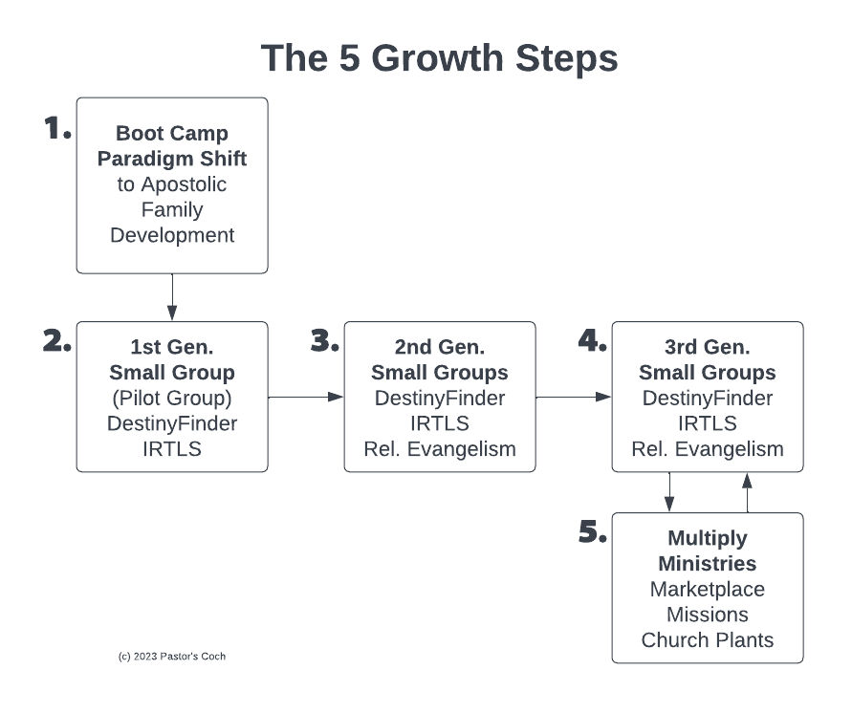

Slide 42
Step 1 is the Boot Camp
It’s 12 modules that will revolutionize your leadership.
Goal: Give the senior pastor a plan to follow that builds a developmental process so that every person in the church becomes a healthy disciple who fulfills their calling and reproduces.
It’s an “inside-out” approach.

Slide 43
The Live Boot Camp
This is the best of the best of our material and training!
12 weeks of Group Coaching: Wed 90-min session each week on Zoom.
Complete detailed Action Plan covering the first 2 years of transition.
Online Road Map webpage with links to all assignments and resources.
Complete Destiny Finder Small Group Program: online tool, 8 videos, Leader Guide, Workbook, email templates, flyer, handout, more.
Quintessential Church Revolution Book: Boot Camp textbook, 260 pages.
Lifetime Access to the resources, and ALL our video courses (300+ hrs)
Real Support: Email, phone, Zoom, Help ticket system.

Slide 44
Destiny
Teaching that’s spiritual, strategic, biblical AND practical
Mod 1: Introduction: Orientation, and how to shift your approach from pastoral to apostolic.
Mod 2: Vision, Mission and Plan: How to get clarity on your call, and develop a plan.
Mod 3: The Quintessential Ministry Gifts: How to implement the fivefold gifts in your church.
Mod 4: Doing Church as a Family: Building with the biblical values of family and multiplication.
Mod 5: Church Culture: Creating a dynamic church.
Mod 6: Destiny Finder: How to use this powerful approach and tool.
Mod 7: People Development: How to make mature disciples who fulfill their calling.
Mod 8: Leadership Development: Developing leaders using our 5-step model.
Mod 9: Team Development: Developing your overseers/elder team.
Mod 10: Small Groups: Launching groups that develop people and multiply.
Mod 11: Outreach & Enfolding: Reaching and keeping new people.
Mod 12: Implementation: The Action Plan to multiply disciples, leaders, groups, ministries, etc.

Slide 45
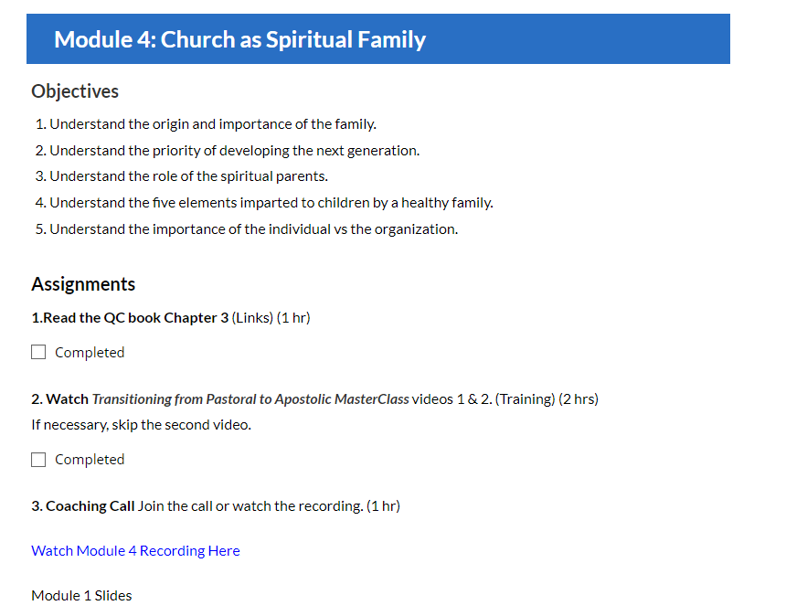
Modules Have Assignments, Links, etc.

Slide 46
Live Boot Camp Starts March 25/26
This is an amazing 12-week training, only offered live once this year.
Boot Camp Live Training Sessions:
Tuesdays Mar 25-Jun 10 from 4-5:30 PM Pacific Time (if enough sign ups)
Wednesdays Mar 26-Jun 11 from 9-10:30 AM Pacific Time
Group Coaching and Support Call (Optional)
Thursdays as needed.
More info and registration: https://pastorscoach.com/bootcamp/

Slide 47
Boot Camp Investment
This is the best of the best of our material and resources! Includes:
12-week program with two weekly live training sessions, courses, Destiny Finder Small Group Program, live support.
Lifetime access to the materials, AND all of our 60+ video courses (300+ hours).
Only offered live once this year. Recordings of sessions are available.
Total value: $9,300. Live Boot Camp Investment: $1,997.
Go to https://pastorscoach.com/bootcamp/ for info and to register.
Special Offer for Early Bird Registration: Sign up by Wed Mar 12, get $1500 off!
Only $497 Special Offer expires Wed Mar 12 at 11:59 PM Pacific! ***
Go to https://pastorscoach.com/bootcamp to register.

Slide 48
Testimonies
There is nothing else quite like this available anywhere!
"Pastor's Coach shaped our journey as we prepared to plant a church.”
-- Banning Liebscher, Director, Jesus Culture Church Sacramento CA USA
“I haven’t had so much fun in ministry since I was in my twenties!”
-- Paul Berteig, Pastor, Genesis Community Church, Prince George Canada: https://pastorscoach.com/video/boot-camp-testimony-paul-berteig/
“20 years in ministry, seven as a Senior Pastor… But I have NEVER come across anything like Pastor’s Coach. I’m only one month into their 2 year Q2Q Church Growth Track, but I am fast becoming convinced that this is THE BEST MATERIAL and MOST EXTRAORDINARY COACHING that I have EVER come across.”
-- Luke Harris, Pastor, Empower Church, The Shire, Cronulla, Australia.

Slide 49
Frequently Asked Questions (FAQs)
We’ve taken over 500 pastors through the Boot Camp over the last 7 years.
Why does it take 2-3 years to fully implement? This is a big shift; it takes a lot of time to change the culture in a church.
Can I do it on my own? Yes, but working with our system, resources and group coaching will greatly accelerate your progress.
Will it really work in my situation (culture, age group, rich/poor, etc.)? Yes, we work with all types of churches around the world.

Slide 50
Contact Us
Please contact us with any questions or meeting requests:
We can do a zoom meeting with your team or elder board to talk about how this will work for your church or ministry.
Call us at +1 (916) 467-9934 Mobile
Email us at info@pastorscoach.com

Slide 51
Another Testimony
We have dozens of testimonies just like this…
“Michael and Glen, I want to express my huge appreciation to you for the Pastor's Coach program. I want to let you know that I get it.
It’s not a program. It’s a total paradigm shift for ministry, out of traditionalism and into the leadership model and church building strategy that Jesus intended. I get the big picture.
The moment I heard that Michael spent 20+ hours per week in face-to-face mentoring, my life was changed forever and there’s no going back. When I understood that personal leadership development and small group team ministry were higher priority than the weekend service, my life changed forever. No going back. Thank you both!”
-- Mike Harding, Senior Pastor, Love Gospel Church, Apache Junction, Arizona, USA (Boot Camp March 2018)

Slide 52
Conclusion
If you don’t develop people, and especially leaders you will
Continue to lead reactively, and suffer accordingly.
Have to do most of the ministry yourself.
See your church cap at 60-100.
Fail at doing the Great Commission to make disciples.
Ultimately fall short of fulfilling your God-given calling.
Your future self is begging you to take the next step with the Boot Camp.

Slide 53
