Slide 1

Developing Leaders Who Multiply
Webinar
Pastor’s Coach Pastorscoach.com © 2025 Quintessant

Slide 2
Introduction
This is primarily for senior pastors.
Our goal is to help you implement immediate changes for health & growth.
Use the chat window for questions (or unmute and ask).
We’ll have some time for Q&A.
You’ll learn things you can use right away; realize we have much more.
We will send you these slides, and a link to the video recording.

Slide 3
Agenda
Presenters
The Goal: Healthy Churches with Godly Leaders
Why Develop Leaders?
What Is a Leader?
How to Develop Leaders
Next Steps: Boot Camp Intro

Slide 4
Presenters
Michael Brodeur DDiv
CEO and Founder of Pastor’s Coach, and Co-Founder of Destiny Finder.
Street ministry and pastor of church plant San Francisco 1975-84
Planted and pastored Vineyard Christian Fellowship church in San Francisco 1984-2005.
Regional Overseer for 25+ Vineyard churches in N. California in 1990s.
Glen Reed, MDiv Western Seminary, MS & BS UC Davis
Partner and Content Manager and Trainer at Pastor’s Coach.
Co-Founder of Destiny Finder (with Michael).
Associate Pastor Vineyard Christian Fellowship San Francisco in the 90s.
Worked in high tech as a technical writer and trainer for over 25 years.

Slide 5
The Goal: Healthy Churches
Healthy churches need members who become godly leaders.
The church has been, and still is, God’s main plan for accomplishing that.
That requires healthy churches that reach new people, turn them into disciples, and help them reproduce and reach others.
The discipleship process focuses on helping people mature.
So ultimately, the goal is for church leadership to lead people into maturity, help them reach others, and reproduce so that they reach more new people.
In this webinar we will only focus on one aspect of church health: developing godly leaders.

Slide 6
Why Develop Leaders?

Slide 7
My Story
My Experience Developing Leaders.
Leader in a Christian house church in San Francisco: High zeal, no process.
Shepherding movement in the 70s: High accountability, focus on control.
Vineyard under John Wimber in the 80s: Intentional approach.
Vineyard SF: Developing leaders, and leaders of leaders (overseers/elders).
Coaching: Working with pastors around the world.

Slide 8
Developing Leaders Is a Challenge
Developing godly leaders is one of the main challenges facing pastors today.
Lack of personal relationship… instead, classes are used.
No developmental process, no hands-on learning.
Either highly relational with little instruction, or high control but no relationship.
Leaders are recruited; but not multiplied: only one generation.
To change this reality, we need to change the way we do church;
we must make leadership development our top priority.

Slide 9
Leaders Are Essential
Churches Need to Grow; Need More Leaders
We have a command from Jesus to make disciples. Matt. 28:19-20
Healthy things grow in quality and quantity.
John Wimber/Fuller Institute of Church Growth Study
Studied 40,000 churches of all types and sizes.
The most important element for growth was healthy leaders.
Yet most church pastors are not reproducing.
Bible schools and seminaries can’t produce enough leaders; We need to shift how we do church!

Slide 10
What Is a Leader Who Multiplies?

Slide 11
Leadership is People Movement
Leadership vs. Discipleship
Discipleship is People Development
Discipleship is about helping people become more like Jesus.
Developing each person into their destiny and calling given by God.
Leadership is People Movement
Leadership is moving and directing people toward a goal.
Healthy leadership includes discipleship; developing individuals as you lead them.

Slide 12
Apostolic Servant Leadership
Three models of leadership
Top down: Classic corporate model; leader at the top of the pyramid: 
Bottom up: Servant leader at the bottom of the pyramid: 
ASL: Leader not top or bottom, in front, moving people forward: 

Slide 13
Leaders and Workers
Leaders and workers are different
Worker: Serves in the presence of their leader (on a team or ministry)
Leader: Leads in absence of their leader (leads a team or ministry)

Slide 14
Family Is the Basic Model
Family is the Model, Approach and Value System
Family exists for the benefit of the next generation.
Spiritual reproduction. You are the “father or mother” to your primary team, but you’re the grandparent to the leaders they are leading (2nd gen).
Jesus and Paul focused on developing a small group of leaders.

Slide 15
Motivating Leaders
Destiny and Calling Are the Primary Motivation
We cover this in other teachings; this is just the overview.
“We are His workmanship, created in Christ Jesus for good works, which God prepared beforehand that we should walk in them.” Eph 2:10
Every believer has a God-given destiny (calling /ministry /life purpose).
Leaders will be motivated by discovering and fulfilling their personal destiny.
Therefore you need to understand the destiny of the leader you are developing, and mentor and guide them to fulfill it.
Service is the vehicle for development; you can’t develop without them serving.
We have a powerful and practical tool to do this: DestinyFinder.com.

Slide 16
How Do You Develop Leaders Who Multiply?

Slide 17
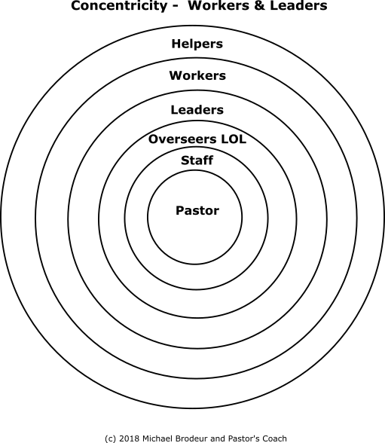
Develop Concentrically
Concentric Model Seen with Moses, Jesus, Paul
Moses and Jethro: Leaders of 10s, 50s, 100s, 1000s.
Jesus: The 3 (Peter James, John), the 12 apostles,
70 sent out, 120 at the Upper Room,
500+ Resurrection witnesses, Multitudes.
Paul: Timothy, Faithful men, Others 2 Tim 2:2.
Helpers, Workers, Assistant Leaders,
Leaders, Leaders of Leaders (Overseers),
Staff, Pastor
Generational hierarchy, not corporate or military.

Slide 18
The IRTLS Leadership Development Model
Intentional, systematic development
Identify: Look for FATR people: Faithful, Available, Teachable, Reproducers.
Recruit: Personally recruit based on their personal destiny and org. vision.
Train: Apprentice model: I show you, I do-you help, you do-I help, you do it.
Launch: Help the leader recruit a team for a ministry, set goals, launch ministry.
Support: The multiplying leader oversees the new leader, and provides reward, nurture and feedback.
Example: Developing and reproducing a small group leader.

Slide 19
Q&A

Slide 20
Next Steps
Pastors: Could you use some help shifting your church to develop leaders?
We’ve given you some of the keys.
Do you want to go deeper?
Do you want to lead your church to be healthy? That means growing in quality AND quantity
Our answer is the Church Growth Track with the Boot Camp
It’s a unique training experience that provides a proven process you can follow to shift your church.

Slide 21
The Track: a 5-Step Plan
We Have a Proven Plan
Step 1 is a 12 module Boot Camp. The Live Boot Camp takes 12 weeks.
Steps 2-5 take place over the next 2-3 years as you implement the program.

Slide 22
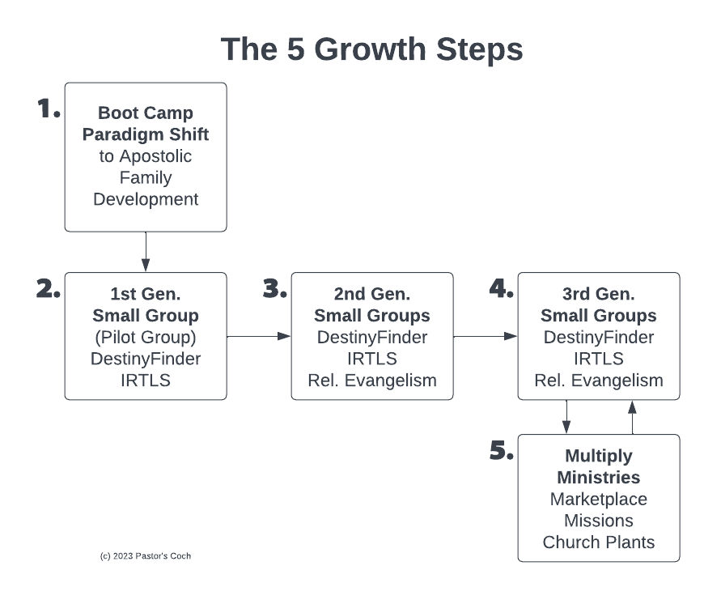

Slide 23
The 5 Growth Steps
Step 1: Boot Camp 12 weeks: Senior pastor gets basic concepts, models, best practices, small group model, makes the paradigm shift personally.
Step 2: Pilot group 12 weeks: Pastor takes leadership team through Destiny Finder, sm. group model, trains them to develop people and lead groups.
Step 3: 2nd Gen Groups 9 months: Pilot Group launches groups for the church, do Destiny Finder, lead great meetings, start developing people.
Reach and Keep: Members reach their Sphere of Influence, some get saved, added to the groups. Church does events, enfolding etc.
Develop Leaders: In each group, the team develops assistants using apprenticeship model.
Step 4: 3rd Gen Groups 9 months: New teams launch new groups, leads great meetings, develops new leaders, etc.
Step 5: Multiply: Continue multiplying everything, launch new
ministries, marketplace emphasis, send missionaries, plant churches.

Slide 24
Step 1 Is the Boot Camp
It’s 12 modules that will revolutionize your leadership.
Goal: Give the senior pastor a plan to follow that builds a developmental process so that every person in the church becomes a healthy disciple who fulfills their calling and reproduces.
It’s an “inside-out” approach.

Slide 25
The Live Boot Camp
This is the best of the best of our material and training!
12 weeks of Group Coaching: Wed 90-minute session each week on Zoom.
Optional Group Coaching: Thurs 60-minute drop-in session for support.
Complete detailed Action Plan covering the first 2 years of transition.
Online Road Map webpage with links to all assignments and resources.
Complete Destiny Finder Small Group Program: online tool, 8 videos, Leader Guide, Workbook, email templates, flyer, handout, more.
Quintessential Church Revolution Book: Boot Camp textbook, 260 pages.
Lifetime Access to the resources, and to ALL our video courses (300+ hrs)
Real Support: Email, phone, Zoom, Help ticket system.

Slide 26
Boot Camp Module Topics
Teaching that’s spiritual, strategic, biblical AND practical
Mod 1: Introduction: Orientation, and how to shift your ministry approach from pastoral to apostolic.
Mod 2: Vision, Mission and Plan: How to get clarity on your call, and develop a plan.
Mod 3: The Quintessential Ministry Gifts: How to implement the fivefold gifts in your church.
Mod 4: Doing Church as a Family: Building with the biblical values of family and multiplication.
Mod 5: Church Culture: Creating a dynamic church.
Mod 6: Destiny Finder: How to use this powerful approach and tool.
Mod 7: People Development: How to make mature disciples who fulfill their calling.
Mod 8: Leadership Development: Developing leaders using our 5-step model.
Mod 9: Team Development: Developing your overseers/elder team.
Mod 10: Small Groups: Launching groups that develop people and multiply.
Mod 11: Outreach and Enfolding: Reaching and keeping new people – achieving 50% yearly growth.
Mod 12: Implementation: The Action Plan to multiply disciples, leaders, groups, ministries, missions, etc.

Slide 27
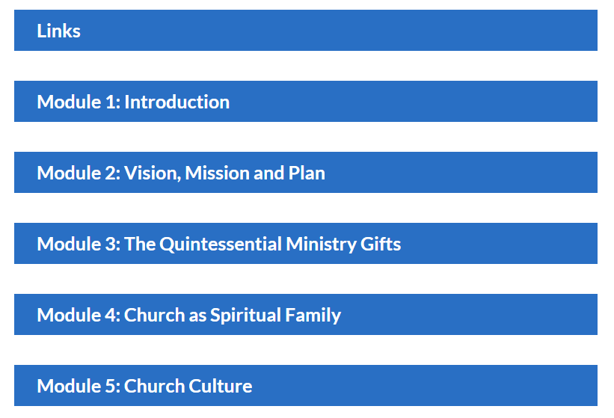
Road Map Webpage: Access Everything

Slide 28
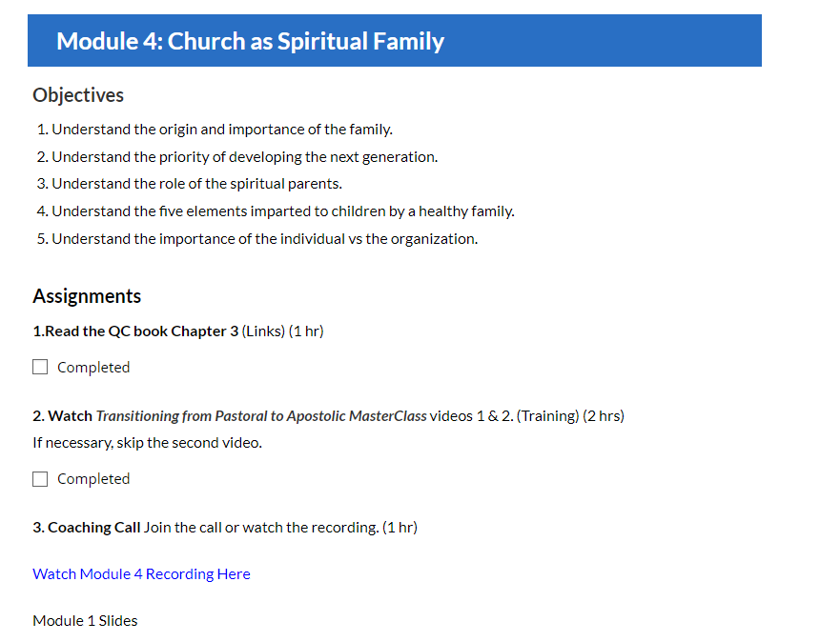
Modules Have Assignments, Links, etc.

Slide 29
Live Boot Camp Starts March 25/26
This is an amazing 12-week training, only offered live once this year.
Boot Camp Live Training Sessions:
Tuesdays Mar 25-Jun 10 from 4-5:30 PM Pacific Time (if enough sign ups)
Wednesdays Mar 26-Jun 11 from 9-10:30 AM Pacific Time
Group Coaching and Support Call (Optional)
Thursdays as needed.
More info and registration: https://pastorscoach.com/bootcamp/

Slide 30
Boot Camp Investment
This is the best of the best of our material and resources! Includes:
12-week program with two weekly live training sessions, courses, Destiny Finder Small Group Program, live support.
Lifetime access to the materials, AND all of our 60+ video courses (300+ hours).
Only offered live once this year. Recordings of sessions are available.
Total value: $9,300. Live Boot Camp Investment: $1,997.
Go to https://pastorscoach.com/bootcamp/ for info and to register.
Special Offer for Early Bird Registration: Sign up by Wed Mar 12, get $1500 off!
Only $497 Special Offer expires Wed Mar 12 at 11:59 PM Pacific! ***
Go to https://pastorscoach.com/bootcamp to register.

Slide 31
Testimonies
There is nothing else quite like this available anywhere!
"Pastor's Coach shaped our journey as we prepared to plant a church.”
-- Banning Liebscher, Director, Jesus Culture Church Sacramento CA USA
“I haven’t had so much fun in ministry since I was in my twenties!”
-- Paul Berteig, Pastor, Genesis Community Church, Prince George Canada: https://pastorscoach.com/video/boot-camp-testimony-paul-berteig/
“20 years in ministry, seven as a Senior Pastor… But I have NEVER come across anything like Pastor’s Coach. I’m only one month into their 2 year Q2Q Church Growth Track, but I am fast becoming convinced that this is THE BEST MATERIAL and MOST EXTRAORDINARY COACHING that I have EVER come across.”
-- Luke Harris, Pastor, Empower Church, The Shire, Cronulla, Australia.

Slide 32
Frequently Asked Questions
We’ve taken over 500 pastors through the Boot Camp over the last 7 years.
Why does it take 2-3 years to fully implement? This is a big shift; it takes a lot of time to change the culture in a church.
Can I do it on my own? Yes, but working with our system, resources and group coaching will greatly accelerate your progress.
Will it really work in my situation (culture, age group, rich/poor, etc.)? Yes, we work with all types of churches around the world.

Slide 33
Contact
Please contact us with any questions or meeting requests:
We can do a zoom meeting with your team or elder board to talk about how this will work for your church or ministry.
Call us at +1 (916) 467-9934 Mobile
Email us at info@pastorscoach.com

Slide 34
Live Boot Camp Starts March 25/26
This is an amazing 12-week training, only offered live once this year.
Boot Camp Live Training Sessions:
Tuesdays Mar 25-Jun 10 from 4-5:30 PM Pacific Time (if enough sign ups)
Wednesdays Mar 26-Jun 11 from 9-10:30 AM Pacific Time
Group Coaching and Support Call (Optional)
Thursdays as needed.
More info and registration: https://pastorscoach.com/bootcamp/

Slide 35
Boot Camp Investment
This is the best of the best of our material and resources! Includes:
12-week program with two weekly live training sessions, courses, Destiny Finder Small Group Program, live support.
Lifetime access to the materials, AND all of our 60+ video courses (300+ hours).
Only offered live once this year. Recordings of sessions are available.
Total value: $9,300. Live Boot Camp Investment: $1,997.
Go to https://pastorscoach.com/bootcamp/ for info and to register.
Special Offer for Early Bird Registration: Sign up by Wed Mar 12, get $1500 off!
Only $497 Special Offer expires Wed Mar 12 at 11:59 PM Pacific! ***
Go to https://pastorscoach.com/bootcamp to register.

Slide 36
What’s the Cost of NOT Changing…
If you don’t develop people, and especially leaders you will
Continue to lead reactively, and suffer accordingly.
Have to do most of the ministry yourself.
See your church cap at 60-100.
Fail at doing the Great Commission to make disciples.
Ultimately fall short of fulfilling your God-given calling.

Slide 37
Conclusion
Do you really want breakthrough?
This is a proven program that brings results.
A copy of these slides will be sent by email.
A recording of this webinar will be available.
Questions: Call +1-916-467-9934 mobile, or email info@pastorscoach.com.
Your future self is begging you to get on board!

Slide 38
Q&A

Slide 39
Another Testimony
We have dozens of testimonies just like this…
“Michael and Glen, I want to express my huge appreciation to you for the Pastor's Coach program. I want to let you know that I get it.
It’s not a program. It’s a total paradigm shift for ministry, out of traditionalism and into the leadership model and church building strategy that Jesus intended. I get the big picture.
The moment I heard that Michael spent 20+ hours per week in face-to-face mentoring, my life was changed forever and there’s no going back. When I understood that personal leadership development and small group team ministry were higher priority than the weekend service, my life changed forever. No going back. Thank you both!”
-- Mike Harding, Senior Pastor, Love Gospel Church, Apache Junction, Arizona, USA (Boot Camp March 2018)

Slide 40
PastorsCoach.com/BootCamp

Slide 41
