Slide 1

Church Growth by Small Groups Webinar
Glen Reed
& Michael Brodeur
Pastor’s Coach
PastorsCoach.com © 2023 Quintessant

Slide 2

Overview
Agenda
Introduction
What’s not working in small groups and why
What was Jesus’ model for ministry
What’s the Biblical approach
What’s the key to multiplying groups
How do you raise up leaders
The Destiny Finder Approach and Small Group Program
Q&A

Slide 3
Presenters
Glen Reed, MDiv Western Seminary, MS & BS UC Davis.
Destiny Finder Co-Founder, Pastors Coach Program Designer, Coach, Trainer.
Associate Pastor at Vineyard Christian Fellowship San Francisco in the 90s.
Worked in high tech as a technical writer and trainer for over 20 years.
Michael Brodeur DDiv
CEO and Founder of Pastor’s Coach and Co-Founder of Destiny Finder.
Planted and pastored Vineyard Christian Fellowship church in San Francisco for 33 years.
Regional overseer for over 25 Vineyard churches in Northern California in the 90s.

Slide 4
What’s the Goal?
Ultimately we want to grow healthy churches with healthy groups
Healthy things grow.
Fulfill Kingdom mandates: Make disciples who make disciples
Disciple people
Reach new people
Provide community, service, body ministry
Fulfill the “one another” verses
Essential it’s healthy discipleship
We approach discipleship from a broad holistic standpoint – it’s helping each individual develop into maturity spiritually, and serve to fulfill their individual calling and destiny as given by the Lord.

Slide 5
What’s Not Working - Church
Most churches are not making disciples.
Focus on Sunday morning service, sermon, worship.
Main approach is lecture; but lecture alone is fairly ineffective for actual learning.
Lacking emphasis and opportunity for application.
Little time spent actually discipling people.
People not committed, take a “cafeteria” approach: sermon at one church, small group at another, fellowship with a different group, worship from YouTube etc.

Slide 6
What’s Not Working - Groups
Most small groups are too pastoral and not enough apostolic
Bible studies provide information download, little application. (Swim class)
Care groups provide community but can become ingrown. (Pity party)
Most groups have no intentional pathway or process that develops people into mature disciples who reproduce.
Eph 4:11-12 Gifts: apostolic, prophetic, evangelistic, pastoral, teaching
Eph 2:20 Foundation is Apostles and Prophets
We focus on function and fruit, not titles
Pastoral gift focuses on caring and keeping, shepherding.
Apostolic gift focuses on training and sending, mobilizing.
Both are important, but when a church and/or group is too pastoral, the people become consumers; “meet my needs.”
Need to shift to be more apostolic and start equipping people.

Slide 7
Jesus’ Model for Ministry
Jesus’ primary means of developing disciples was a small group
He preached and taught to thousands.
He healed and cast out demons from hundreds.
He interacted with various individuals on a daily basis.
BUT he most of his time for three years with the 12 and a few others.
He used the apprenticeship model (showed them, then helped them do it , then let them do it on their own.)
Sometimes he would just thrust them into ministry and explain later.
He did “life on life” with them.
Key: He focused on 12, and especially on 3, and they became the foundation for the church once he ascended.

Slide 8
The Early Church’s Model for Ministry
The church met in the Temple and house to house.
Acts 2:42 They were continually devoting themselves to the apostles’ teaching and to fellowship, to the breaking of bread and to prayer.
43 Everyone kept feeling a sense of awe; and many wonders and signs were taking place through the apostles.
44 And all those who had believed were together and had all things in common;
45 and they began selling their property and possessions and were sharing them with all, as anyone might have need.
46 Day by day continuing with one mind in the temple, and breaking bread from house to house, they were taking their meals together with gladness and sincerity of heart,
47 praising God and having favor with all the people. Acts 2:42-47

Slide 9
The Apostle Paul’s Model for Ministry
The church has two wings: publically and house to house.
Paul says to the Ephesian elders
“…how I did not shrink from declaring to you anything that was profitable, and teaching you publicly and from house to house,” Acts 20:20.
Publically – the large group meeting
House to House – the small group meeting
In I Cor. 12 and 14 Paul talks about ministering to each other in a small group through spiritual gifts.

Slide 10
The “One Another” Ministry Verses
There are 47 “one another” verses in the NT for believers; these can generally only be fulfilled in small groups not large services.
Examples:
Be at peace with one another (Mk 9:50)
Don’t grumble among one another (Jn 6:43)
Be of the same mind with one another (Rom 12:16, 15:5)
Accept one another (Rom 15:7)
Don’t boastfully challenge or envy one another (Gal 5:26).
Gently, patiently tolerate one another (Eph 4:2)
Be kind, tender-hearted, and forgiving to one another (Eph 4:32)
Bear with and forgive one another (Col 3:13)
Seek good for one another, and don’t repay evil for evil (1 Thes 5:15)
Don’t complain against one another (Jas 4:11, 5:9)
Confess sins to one another (Jas 5:16)

Slide 11
Small Group vs. Large Group
Large group meetings are your “tribe.”
Best preachers and teachers.
Best worship team.
Great for momentum, vision casting, celebration, teaching.
Ideal gathering point but not great for individual development.
Small groups are your “family.”
Small number enables relationship; individuals can know and be known.
Ideal environment for people to begin to use their gifts and serve.
Basic pastoral care can take place as the body members minister to each other.
Leaders can focus on developing group members into their destiny and calling.
Train members to reach out to non-Christians, group events help bring them in.
Key: Both are important, keep them focused on their strength; don’t duplicate.

Slide 12
Overall Biblical Approach
Keys
The Family is the basic model and value system: goal is to develop the next generation.
Key is to shift the church and groups to be more apostolic (train and send).
Focus on making disciples (developing people) and reaching new people.
Developing people means helping them fulfill their calling by using their gifts and serving.
Multiply small groups led by teams that:
  Lead great meetings.
  Develop the members to fulfill their calling and serve in ministry.
  Intentionally develop new leaders by apprenticeship.
  Facilitate reaching new people
Leadership Development model: Identify, Recruit, Train, Launch, Support (IRTLS)
Key: Small groups can be “destiny incubators” to develop people into their calling and reach new people.

Slide 13
Q&A
Ask please!

Slide 14
The Destiny Approach
We believe “destiny” is the greatest motivation for human beings
Destiny: one’s purpose, ministry, calling, or dream.
“For we are His workmanship, created in Christ Jesus for good works, which God prepared beforehand so that we would walk in them.” Eph. 2:10
So Fulfilling your Destiny means doing those good works that God has prepared; actually doing what God has called you and designed you to do.
When a person gets a vision for their destiny and calling, they will be motivated from within like nothing else. And they will do something!
“Vision is the fuel for motivation, and motivation is the engine for change.”

Slide 15
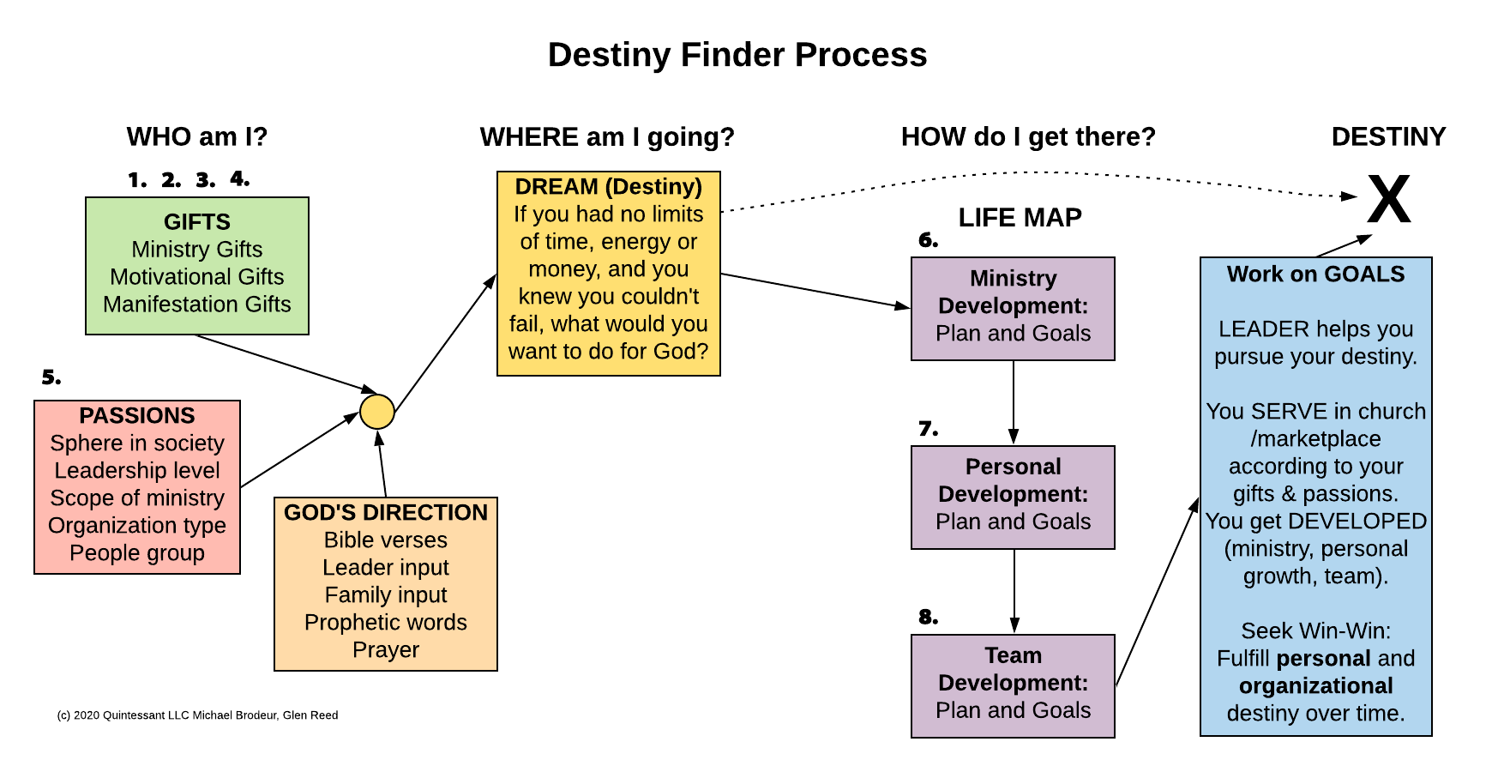

Slide 16
Destiny Finder Small Group Model
This model has multiple purposes: community, individual development, mobilizing for ministry, evangelism, leadership development and multiply the groups.
Launch with 10-15+ multiply at 20-25.
The Team is five people, and their roles represent the five-fold ministry of Eph. 4:11.
Short term: 8-12 weeks. Extended: 7-9 months because it takes time to develop leaders.
Multiply every year.
The team leads great meetings.
The team personally facilitates individuals pursuing their destiny and calling.
The team uses the IRTLS model to develop new leaders; they personally Identify, and Recruit assistant leaders.
They Train assistants by “on the job” training; they will lead a new group.
The group reaches new people through relational evangelism.
As the group grows and as the assistants get trained, it can multiply; the former assistants are now Launched to lead new groups.
The original team continues to Support the new team.
Key: Training uses an apprenticeship model.

Slide 17
Small Group Team
Team of five people representing the five ministry gifts of Eph 4:7-16
Ministry is distributed:
Small group leader (Apostolic)
Worship leader and prayer (Prophetic)
Outreach worker (Evangelistic)
Host, pastoral care (Pastoral)
Growth coach, training, discipling (Teaching)
Assistant group leader; one of the other four is also the assistant leader.
Key: Focus on function and fruit, not position and title.
Key: The main goal is equipping others – Eph. 4:12

Slide 18
Two Hour Format
It’s important to start and stop on time.
20 min Intro and Worship
10 min Outreach worker (or other) shares short teaching or exhortation
20 min Teaching; live or video
5-15 min Personal self study (depends on topic or curriculum)
20 min Clusters of 3-4 discuss (do large group discussion at times)
15 min Clusters (Mini-groups) pray for each other
10 min Other ministry
10 min Group prayer or activity
KEY: For most meetings, have at least 20 min of sharing with mini-groups of 3 or 4 to enable people to connect.

Slide 19
Group Life Cycle
It takes TIME to develop people, especially if they have no previous ministry experience or are new believers. The groups multiply each year.
Months 1-3 The group does Destiny Finder, group gets to know each other.
Months 3-4 The five team members recruit and begin training assistants.
Months 4-9 The assistants are apprenticed / trained on-the-job, and over time the assistants are able to take over and fulfill the role themselves.
The group can use almost any curriculum as long as the focus remains on interaction and development. The team continues to meet with people individually to develop them into their destiny and mobilizing for service.
Months 10-12 Break, prepare for launch of new groups
Next year: The new team is able to launch a new group. Or team members can be matched up with more experienced leaders to form the new teams.

Slide 20
Relational Evangelism
Relational or lifestyle evangelism is the key to babies in the house!
Most people come to faith through friendship relationship with a Christian.
Many believers have little or no meaningful friendships with non-Christians.
Must build trust for people to be open to hear the message and be willing to change beliefs.
Small groups are the “platform” for outreach, but not primarily to invite people to the regular group meeting.
Members of the group need to reach out to their Sphere of Influence (SOI) and develop friendships which lead to opportunities to share faith and love.
SOI are the people you have regular contact with: family, friends, co-workers, activity group members, neighbors, family of friends.

Slide 21
Small Group Events and Outreach
Fun, casual events facilitate community and interaction with one’s sphere of influence.
The group does special events with its members or other groups: parties, picnics, worship nights etc. (casual and relational, with food and drink)
Group does “bridge” events: fun, casual relational events that group members can invite non-Christian friends to, to increase connection with Christians in their SOI.
Invite some Christians from the group, some non-Christians.
This provides opportunities to interact with people and minister to them.
Examples: parties, barbeques, service projects, dinners, sports events gatherings such as Super Bowl or World Cup.
Key: Focus on building trust, relational evangelism, lifestyle not event.

Slide 22
DF Small Group Program
Comprehensive approach focused on development and multiplication
Includes everything to launch and run a DF group:
DF Workshop Videos: 8 30-min HD teaching by Michael Brodeur
The Destiny Finder Journey Guide PRO online tool: assessments, life mapping (each group member needs their own online account)
Workbook
Leader Guide
Handout
Flyer
Email Templates for reminders
Profiler Questions and Gift Descriptions
Other Training is available (Small Group MasterClasses, etc. on pastorscoach.com).

Slide 23
Q & A

Slide 24
Next Step
Pastors: Could you use some help shifting your church to be more apostolic and growing?
We’ve given you some of the keys, concepts and models.
You can apply them as best as you can by yourself and press forward on your journey.
Or you can have someone who’s been there help you.
Small Group Leaders: Do you want help doing a small group? We’ll cover that at the end.

Slide 25
Pastors: We can help!
We can help you make the shift to a dynamic church that is multiplying healthy disciples, leaders and ministries.
Our answer is the Church Growth Track with the Boot Camp
It’s a unique training experience that provides a proven process you can follow to shift your church.
It’s Biblical, strategic, spiritual, practical… and affordable.
There is nothing else like it available (especially with live group coaching)

Slide 26
The Includes
Step 1 is a three month Live Boot Camp.
Steps 2-5 take place over the next 2-3 years as you implement the program.
We’ll be launching a Group Coaching Program and a One-On-One Coaching Program after the Boot Camp.

Slide 27
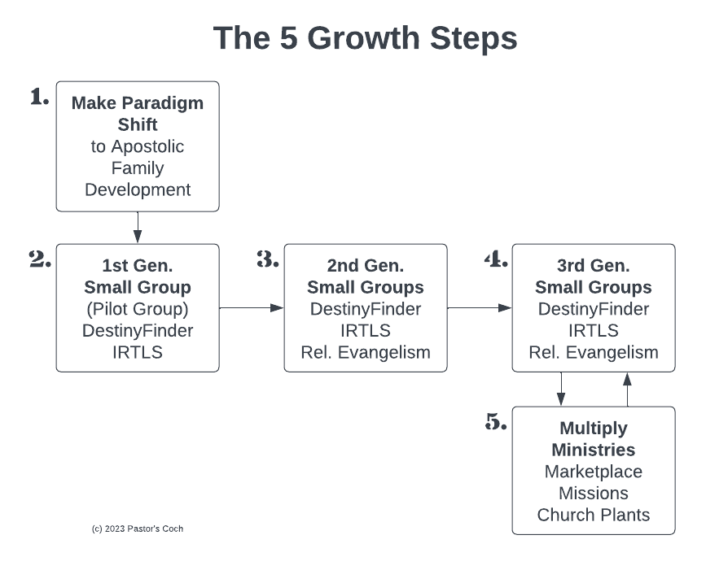

Slide 28
The 5 Growth Steps
Step 1: Boot Camp 12 wks. - Senior pastor gets basic concepts, models, best practices, small group model, makes the shift personally.
Step 2: Pilot group 12 wks. – Pastor takes leadership team through Destiny Finder, sm. group model, trains them to develop people and lead groups.
Step 3: 2nd Gen Groups 9 mos. – Pilot Group launches groups for the church, do Destiny Finder, lead great meetings, start developing people.
Reach and Keep – Members reach their Sphere of Influence, some get saved, added to the groups. Church does events, enfolding etc.
Develop Leaders – In each group, the team develops assistants using apprenticeship model.
Step 4: 3rd Gen Groups 9 mos. – New teams launch new groups, leads great meetings, develops new leaders, etc.
Step 5: Multiply – Continue multiplying everything, launch new ministries, marketplace emphasis, send missionaries, plant churches.

Slide 29
The Process
Teach the pastor the essential keys to church health and growth following the 5 Steps.
Help him/her make the shift personally.
Reproduce that in the leadership team.
Reproduce that in every member.

Slide 30
Step 1: the Boot Camp
Step 1 is the Boot Camp Yr 1.
It’s 12 weeks that will revolutionize your leadership.
Goal: Give the senior pastor a plan to follow that builds a developmental process so that every person in the church becomes a healthy disciple who fulfills their calling and reproduces.

Slide 31
The Live Boot Camp
This is the best of the best of our material and training!
12 weeks live 90-minute training session each week online (Zoom).
12 weeks optional live group coaching call for support, Q&A.
Complete detailed Action Plan covering the first 2 years of transition.
Online Road Map with all assignments and schedule.
Complete Destiny Finder Small Group Program: online tool, 8 videos, Leader Guide, Workbook, email templates, flyer, handout, more.
Quintessential Church Revolution Book: Boot Camp textbook, 260 pages.
Additional video courses.
Email, phone, Help ticket support.
Lifetime access to the included training videos and additional video courses.
Averages 3-4 hours of work per week (includes the weekly training).

Slide 32
Boot Camp Class Topics
Teaching that’s spiritual, strategic, biblical AND practical
Shifting from pastoral to apostolic
Implementing the Quintessential “Fivefold” Ministry Gifts in your church
Doing church as a spiritual family
Creating a dynamic church culture
Developing people using Destiny Finder
Developing leaders using our 5-step Leader Development model
Developing teams and realigning your elder team
Launching small groups that develop people and multiply
Reaching and keeping new people – achieving 50% yearly growth
Multiplying leaders, groups, ministries, facilities, missions

Slide 33
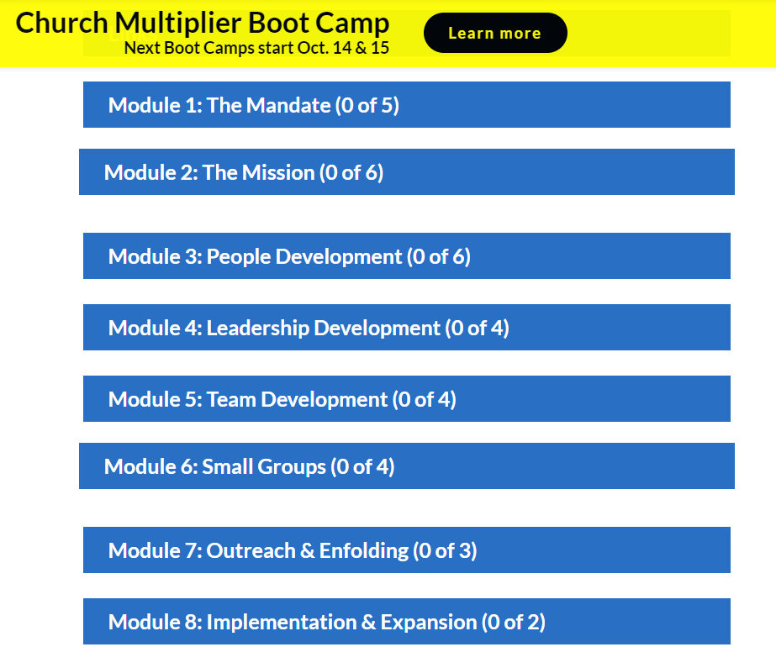
Road Map

Slide 34
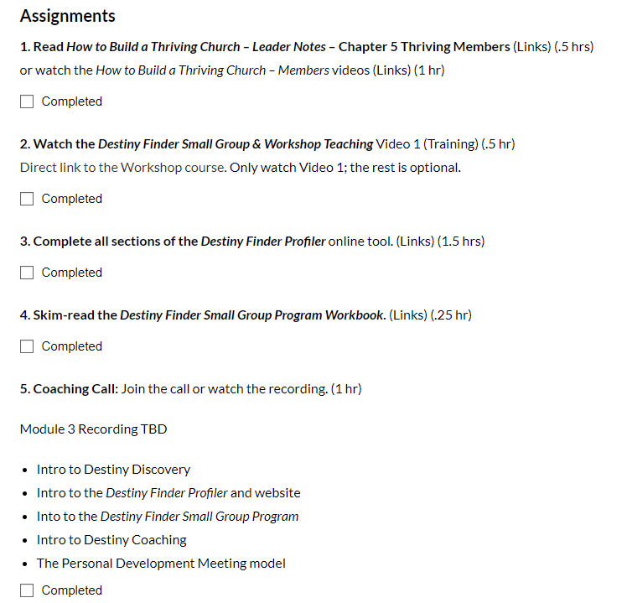
Module Assignments

Slide 35
Includes the Destiny Finder Small Group Program
Powerful small groups that go way beyond the typical small group:
Video Teaching: Eight 30-min videos covering the entire destiny process.
Destiny Finder Journey Guide PRO tool for developing people
  Profiler, Mapper and Tracker assessments and modules https://destinyfinder.com/
Leader Guide 25 pp
Workbook 48 pp
Email templates
Handout and Flyer
List of all assessment questions and complete gift descriptions
Complete Destiny Finder book (220 pp)
Go to https://destinyfinder.com/smallgroups/

Slide 36
Boot Camp Starts April 18
This is an amazing 12-week training experience.
Boot Camp Training Sessions:
Tues April 18-July 6 from 9-10:30 AM Pacific Time
Group Coaching and Support Call (Optional)
Thursdays from 9-10 AM Pacific Time
More info and sign up: https://pastorscoach.com/

Slide 37
Boot Camp Pricing
This is the best of the best of our material and resources! Includes:
12-week program with the live class, courses, Destiny Finder Small Group Program, Small Group Leader Training, lifetime access to the material.
Only offered live once. It will be recorded and included in other programs.
Total value: $5000.
Boot Camp Investment: $1997 or 3 x $749 (3 monthly payments).
Go to pastorscoach.com, select the option, complete the order.
Offer for Webinar participants: If you sign up by April 10 you will receive two free personal one-on-one coaching calls (reg. $400).
Special Offer expires Mon April 10 at midnight! ***

Slide 38
Testimonies
There is nothing else quite like this available anywhere!
"Pastor's Coach shaped our journey as we prepared to plant a church.“
-- Banning Liebscher, Director, Jesus Culture Church Sacramento CA USA
Paul Berteig, pastor of Genesis Community Church in Prince George Canada: https://pastorscoach.com/video/boot-camp-testimony-paul-berteig/
“20 years in ministry, seven as a Senior Pastor… But I have NEVER come across anything like Pastor’s Coach. I’m only one month into their 2 year Q2Q Church Growth Track, but I am fast becoming convinced that this is THE BEST MATERIAL and MOST EXTRAORDINARY COACHING that I have EVER come across. Do yourself a favour - connect with Pastors Coach - it’ll be one of the best and most defining decisions of your ministry.“ -- Luke Harris, Senior Pastor, Empower Church - The Shire, Cronulla, Australia.

Slide 39
More Testimonies
There is nothing else quite like this available anywhere!
“Glen, I want to express my huge appreciation to you and Michael for the Pastor’s Coach program. I want to let you know that I get it. It’s not a program. It’s a total paradigm shift for ministry, out of traditionalism and into the leadership model and church building strategy that Jesus intended. I get the big picture. The moment I heard that Michael spent 20+ hours per week in face-to-face mentoring, my life was changed forever and there’s no going back. When I understood that personal leadership development and small group team ministry were higher priority than the weekend service, my life changed forever. No going back. Thank you both! -- Mike Harding, Senior Pastor, Love Gospel Church, Apache Junction, Arizona, USA
“…You guys are literally helping to shape us from the ground up..."
-- Adam Mathias, Pastor, Kindle Church, Pontypridd, Wales, UK

Slide 40
Contact
Please contact us with any questions or meeting requests:
We can do a zoom or Skype meeting with your team or elder board to talk about how this will work for your church or ministry.
Call us at +1 (916) 467-9934
Email us at info@pastorscoach.com
Destiny Finder Small Group Program: https://destinyfinder.com/smallgroups/

Slide 41
Boot Camp Starts April 18
This is an amazing 12-week training experience.
Boot Camp Training Sessions:
Tues April 18-July 6 from 9-10:30 AM Pacific Time
Group Coaching and Support Call (Optional)
Thursdays from 9-10 AM Pacific Time
More info and sign up: https://pastorscoach.com/

Slide 42
Boot Camp Pricing
This is the best of the best of our material and resources! Includes:
12-week program with the live class, courses, Destiny Finder Small Group Program, Small Group Leader Training, lifetime access to the material.
Only offered live once. It will be recorded and included in other programs.
Total value: $5000.
Boot Camp Investment: $1997 or 3 x $749 (3 monthly payments).
Go to pastorscoach.com, select the option, complete the order.
Offer for Webinar participants: If you sign up by April 10 you will receive two free personal one-on-one coaching calls (reg. $400).
Special Offer expires Mon April 10 at midnight! ***

Slide 43
Pastor Testimony
Michael and Glen, I want to express my huge appreciation to you for the Pastor's Coach program. I want to let you know that I get it.
It’s not a program. It’s a total paradigm shift for ministry, out of traditionalism and into the leadership model and church building strategy that Jesus intended. I get the big picture.
The moment I heard that Michael spent 20+ hours per week in face-to-face mentoring, my life was changed forever and there’s no going back. When I understood that personal leadership development and small group team ministry were higher priority than the weekend service, my life changed forever. No going back. Thank you both!
-- Mike Harding, Senior Pastor, Love Gospel Church, Apache Junction, Arizona, USA (Boot Camp March 2018)

Slide 44
Questions
Why does it take 2-3 years to fully implement? This is a big shift, it takes a lot of time to change the culture in a church.
Can I do it on my own? Yes but working with a coach will greatly accelerate your progress.
Will it really work in my situation (culture, age group, rich/poor, etc.)? Yes, we work with all types of churches around the world.

Slide 45
Conclusion
A copy of these slides will be sent by email.
A recording of this webinar will be available.
Questions: Call us at +1-916-671-0146 (mobile or WhatsApp).
Your future self is begging you to get on board!

Slide 46
Q&A
Ask please!

Slide 47


