Slide 1

Church CPR
Webinar
Pastor’s Coach Mar 2023
Pastorscoach.com © 2023 Quintessant

Slide 2

Introduction
Our goal is to help you implement immediate changes for health & growth.
This is primarily for senior pastors.
Use the chat window for questions (or unmute and ask).
We’ll have some time for Q&A.
You’ll learn things you can use right away; realize we have much more.
We will send you these slides, a link to the video recordings, and a bonus.

Slide 3
Agenda
The Problem
The Solution
Develop Leaders
Develop Members
Reach New People
Upcoming Boot Camp

Slide 4
Presenters
Glen Reed, MDiv Western Seminary, MS & BS UC Davis.
Co-Founder of Destiny Finder, Assistant Director, Pastors Coach.
Associate Pastor at Vineyard Christian Fellowship San Francisco in the 90s.
Worked in high tech as a technical writer and trainer for over 25 years.
Michael Brodeur DDiv
CEO and Founder of Pastor’s Coach, and Co-Founder of Destiny Finder.
Street ministry and pastor of church plant San Francisco 1975-84
Planted and pastored Vineyard Christian Fellowship church in San Francisco 1984-2005.
Regional Overseer for 25+ Vineyard churches in Nor. California in 1990s.

Slide 5
The Goal
We need to grow in quality AND quantity
The Great Commission: Make disciples Matt. 28:19-20
Every disciple should reproduce by making more disciples
Healthy things grow in quality and quantity
Believers will account to God for what they have accomplished 2 Cor 5:10
Jesus died for a bride and He wants more to be saved.

Slide 6
The Problem

Slide 7
Churches Not Growing
Churches in decline
Churches not baptizing many new converts
Congregations getting older, fewer young people
US Study: Churches growing less than population growth in every county.
Impact on society less and less.
Most believers have little meaningful interaction with non-Christians.
Church budget and activities: not much spent on outreach.

Slide 8
People Not Growing, Not Volunteering
Barna Poll
Over 80% of Pastors said,
I feel most alive, most impactful when preaching
But, they also said their two biggest problems were:
My people are not spiritual enough
We don’t have enough volunteers
Do you see the disconnect?

Slide 9
The Root Causes

Slide 10
Overemphasis on the Pastoral
Focus on Pastoral not Apostolic
Ministry gifts Eph 4:11: apostle, prophet, evangelist, pastor, teacher.
Their purpose is in v12: Equip the saints (the members) for ministry
This is the “architecture” of the church.
All are important, but most churches focus on the pastor and teacher gifts.
Pastoral: Shepherd, care and keep. Teaching: Bible, truth, principles.
The focus is on positions and titles.
The pastor becomes the center; the “minister” does the ministry.
The people become consumers, look to the pastor to “meet my needs.”

Slide 11
Priesthood of the Believer
Priesthood of every believer
Jesus died that we might become kings and priests Rev 1:6.
Protestant Reformation: Salvation by Faith, Authority of Scripture, Priesthood of every believer.
But the Priesthood of every believer never fully implemented.
Most churches: only 20% mobilized, the rest are spectators.

Slide 12
Wrong Church Model
Three types of churches
Fantasy: Lots of talk and activity but few results. Basketball with no hoop.
Factory: Highly structured, people become like employees.
Family: Spiritual fathers and mothers intentionally developing spiritual sons and daughters into spiritual fathers and mothers who reproduce. This is the model for church.

Slide 13
Not Developing Members
Classroom approach vs Apprenticeship
Few pastors and leaders are actually personally discipling people
Sun morning good for vision casting, teaching, vision, but not discipleship.
Discipleship is seen as a class rather than developing people for their calling
Classroom approach provides information download, little application.
Lecture is the least effective method for learning, if no application.
Development is messy (think family). One hour a week should do it...
Class on How to Swim

Slide 14
Not Developing Leaders
Not enough healthy leaders
John Wimber and Fuller Institute of Church Growth: Studied 40,000 churches of all types and sizes.
Finding: Most important element for growth was healthy leaders.
Healthy leaders develop and lead others, and reproduce.
Leaders are the “bones” of the body… support growth.
Most church pastors and elders are not reproducing leaders.
It takes time and energy to develop leaders
You only have so much time; one person can only personally “pastor” around 70 people; maybe 100 if you’re super gifted, so need to focus on it.

Slide 15
The Solution

Slide 16
Paradigm Shift
What is a paradigm?
Insanity is doing the same thing over and over again and expecting different results.
We have to do church differently.
This is extremely challenging because of the traditional mindset.
We called this “Church CPR” for a reason…

Slide 17
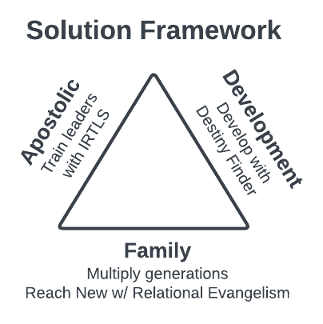
Apostolic Family Development

Slide 18
Apostolic Family Development Framework
Apostolic
Shift from pastoral to apostolic (train and send) and be proactive.
Train leaders using Identify-Recruit-Train-Launch-Support (IRTLS) model.
Family
Shift from fantasy and factory to family model. Multiply generations: Grandparents – Parents – Children.
Healthy parents reproduce: Reach new people with relational evangelism.
Development
Shift from delegation to development: a more holistic and comprehensive (and biblical) approach to discipleship.
Use Destiny Finder approach: develop people to fulfill God-given calling.

Slide 19
Develop Leaders

Slide 20
Jesus’ Model for Ministry
Jesus’ primary means of developing disciples/leaders was a small group
He preached and taught to thousands.
He healed and cast out demons from hundreds.
He interacted with various individuals on a daily basis.
BUT he spent the bulk of his time for three years with the 12 apostles
He used the apprenticeship model (showed them, then helped them do it , then let them do it on their own.)
Sometimes he would just thrust them into ministry and explain later.
He did “life on life” with them.
Key: He focused on 12, and especially on 3, and they became the leaders for the new church.

Slide 21
Developing Leaders
Keep in Mind: Family is the basic model and value system
Family exists for the benefit of the next generation.
Spiritual reproduction. You are the grandparent to leaders of leaders who are parents to the next generation of leaders.
General Leader Development Model - IRTLS
Identify: Look for FATR people: Faithful, Available, Teachable, Reproducers
Recruit: Personally recruit, lead with vision and personal destiny
Train: Apprentice model: I show you, I do - you help, you do- I help, you do it
Launch: Leader recruits a team for a ministry, launch ministry with goal
Support: You oversee the leader and provide nurture and feedback

Slide 22
Leaders of Leaders (Elders)
Breaking growth barriers requires leaders who lead other leaders
The key to breaking 70 is developing leaders. The key to breaking 200 is developing leaders of leaders. Must multiply yourself through other leaders.
Helper: Helps spontaneously, no job description (set up chairs, etc.)
Worker: Defined job description (group, set up team, serves regularly)
Assistant Leader: Leads in presence of their leader (assistant in a team)
Leader: Leads in absence of their leader (leads a team or ministry)
Overseer: Leader of leaders, also called Elders; volunteer position
Staff Pastor: Leads overseers, paid position (associate pastor, etc)
KEY: Develop your overseers / leaders of leaders who are volunteers. This shows the value of every member contributing, not just paid staff.

Slide 23
Develop Members

Slide 24
Create a Model of Development
Clarify your values and priorities
Define the goals and processes of discipleship in your Church.
Develop an “onboarding track” of classes (membership or how to get involved, etc. classes).
Develop Small Groups, and Departments. Do development in each of them.
Destiny Finder, a fresh approach: https://destinyfinder.com/ Delight Directed Discipleship.
Destiny becomes the key, the vision that motivates people from the heart.

Slide 25
Destiny Finder Approach
Destiny: an individual’s mission, calling, ministry, purpose, or dream.
We are designed for destiny: Ps 139 Created for good works: Eph 2:10
Our gifts and passions point towards our destiny.
Each believer will be accountable for what they have done. 2 Cor. 5:10
Every person in the Bible was called to a mission or ministry – to DO something.
Problem: How to develop people: need to customize for each individual.
Every church needs to be a destiny incubator.
Reward-based motivation is the primary way God works (70% of promises). Heb 11:6, 12:2
Shift from duty-driven to delight-directed discipleship.
People will be most fulfilled AND most productive when fulfilling their calling.
Bring personal destiny and organizational destiny together: win-win.
KEY: Develop each individual for destiny; use the DestinyFinder.com tool.

Slide 26
The Journey Guide
Online tool for discovering and fulfilling one’s God-given calling.
Who Am I? Understand my design, wiring, gifts, talents, experiences, passions.
Where am I going? Clarify my dream (destiny, calling, mission, purpose, ministry).
How can I get there? Service is the way to develop. Create a life map, set practical goals to begin doing what God has called you to do.
It has three sections:
The Profiler covers the first two questions, with assessments and worksheets to discover one's gifts and design, culminating with defining one's dream or destiny.
The Mapper covers the last question. It includes worksheets and assessments to address ministry requirements, personal growth issues, and team needs. The user sets goals in each area.
The Tracker lists all the goals, and enables the user to manage their goals.

Slide 27
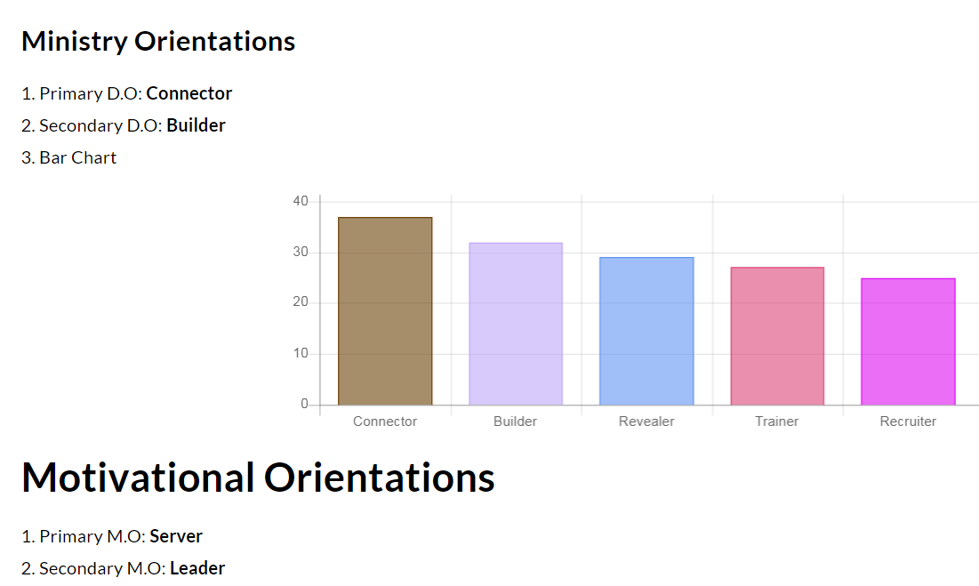
Journey Guide Assessment Results
Assessment Summary

Slide 28
Destiny Fulfillment
Once you understand the destination (the dream) then you need to develop a plan to fulfill it.
Leadership works with the person to develop them according to their gifts, passions & calling.
Service is the vehicle for development.
Create a win-win between individual and church.
This is discipleship: develop each person in their calling and reproduce in others.

Slide 29
Reach the Lost

Slide 30
The Biblical Basis for Outreach
For God so loved the world…
Jesus came to seek and save that which was lost. Luke 19:10
Jesus commands us to go and to preach. Mark. 16:15
The Gospel is the power of God for Salvation. Rom. 1:16
The Great Commission: Go… Make disciples… and teach them what I’ve taught you = Make disciplemakers.
Everything we do can be accomplished better in heaven…except evangelism. We must make evangelism a priority.

Slide 31
Relational Evangelism
Reach one’s sphere of influence (SOI).
Relational evangelism proven to be the way most people come into the Kingdom. Other types of evangelism should supplement it.
Relational: Invite to coffee, lunch, etc.; food is great! Have conversations, and build trust, so that the person will truly listen to the message.
Look for felt needs (health, job, family) and try to meet needs.
Pray for the need in their presence. Keep it simple and non churchy.
They will be impacted: if they are open at all they will ask you questions; that gives you permission to share more.
Train your members to share the gospel (4 spiritual laws), use role playing.
Celebrate every effort – even the unsuccessful ones. Do testimonies, etc.

Slide 32
Create a Culture of Outreach
Clarify your values and priorities.
Develop a culture of outreach and evangelism.
You are the primary cultural influencer in your church.
You and your leaders must teach, model and celebrate evangelism.
Use IRTLS to develop the evangelists and help them understand they need to equip others.
Weave evangelism into every small group and ministry.

Slide 33
Q & A

Slide 34
Next Steps
Pastors: Could you use some help shifting your church?
We’ve given you some of the keys. You can apply them yourself or you can have someone who’s been there help you.
We can help you!
Our answer is the Church Growth Track with the Boot Camp
It’s a unique training experience that provides a proven process you can follow to shift your church.

Slide 35
The Track Includes
Step 1 is a three-month Live Boot Camp.
Steps 2-5 take place over the next 2-3 years as you implement the program.
We’ll be launching a Group Coaching Program and a One-On-One Coaching Program after the Boot Camp.

Slide 36
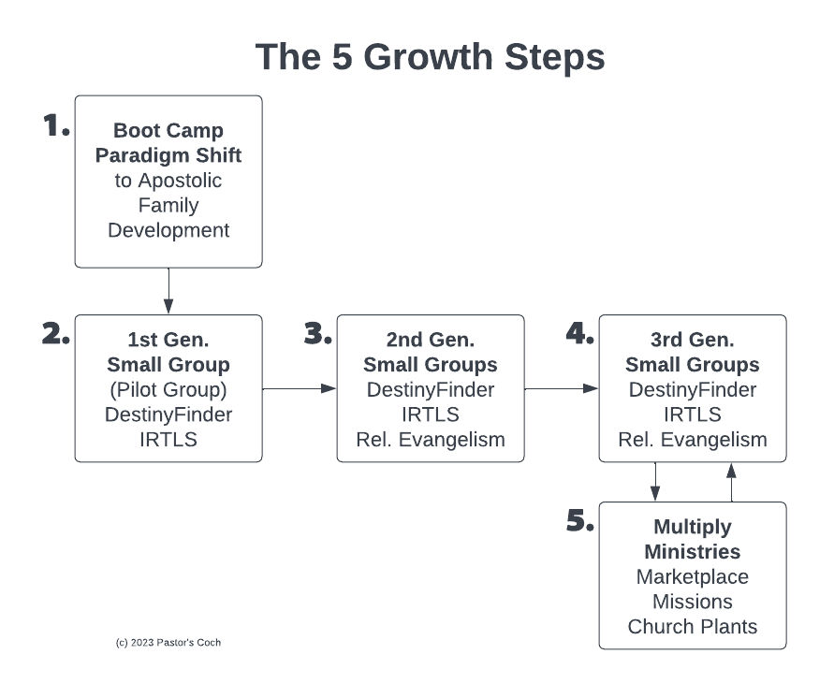

Slide 37
The 5 Growth Steps
Step 1: Boot Camp 12 wks. - Senior pastor gets basic concepts, models, best practices, small group model, makes the paradigm shift personally.
Step 2: Pilot group 12 wks. – Pastor takes leadership team through Destiny Finder, sm. group model, trains them to develop people and lead groups.
Step 3: 2nd Gen Groups 9 mos. – Pilot Group launches groups for the church, do Destiny Finder, lead great meetings, start developing people.
Reach and Keep – Members reach their Sphere of Influence, some get saved, added to the groups. Church does events, enfolding etc.
Develop Leaders – In each group, the team develops assistants using apprenticeship model.
Step 4: 3rd Gen Groups 9 mos. – New teams launch new groups, leads great meetings, develops new leaders, etc.
Step 5: Multiply – Continue multiplying everything, launch new ministries, marketplace emphasis, send missionaries, plant churches.

Slide 38
Step 1: the Boot Camp
Step 1 is the Boot Camp Yr 1.
It’s 12 weeks that will revolutionize your leadership.
Goal: Give the senior pastor a plan to follow that builds a developmental process so that every person in the church becomes a healthy disciple who fulfills their calling and reproduces.
It’s an “inside-out” approach.

Slide 39
The Live Boot Camp
This is the best of the best of our material and training!
12 weeks live 90-minute training session each week online (Zoom).
12 weeks optional live group coaching call for support, Q&A.
Complete detailed Action Plan covering the first 2 years of transition.
Online Road Map with all assignments and schedule.
Complete Destiny Finder Small Group Program: online tool, 8 videos, Leader Guide, Workbook, email templates, flyer, handout, more.
Quintessential Church Revolution Book: Boot Camp textbook, 260 pages.
Additional video courses.
Real Support: Email, phone, Zoom, Help ticket system.
Lifetime access to the included training videos and additional video courses.
Averages 3-4 hours of work per week (includes the weekly training).

Slide 40
Boot Camp Class Topics
Teaching that’s spiritual, strategic, biblical AND practical
Shifting from pastoral to apostolic
Implementing the Quintessential “Fivefold” Ministry Gifts in your church
Doing church as a spiritual family
Creating a dynamic church culture
Developing people using Destiny Finder
Developing leaders using our 5-step Leader Development model
Developing teams and realigning your elder team
Launching small groups that develop people and multiply
Reaching and keeping new people – achieving 50% yearly growth
Multiplying leaders, groups, ministries, facilities, missions

Slide 41
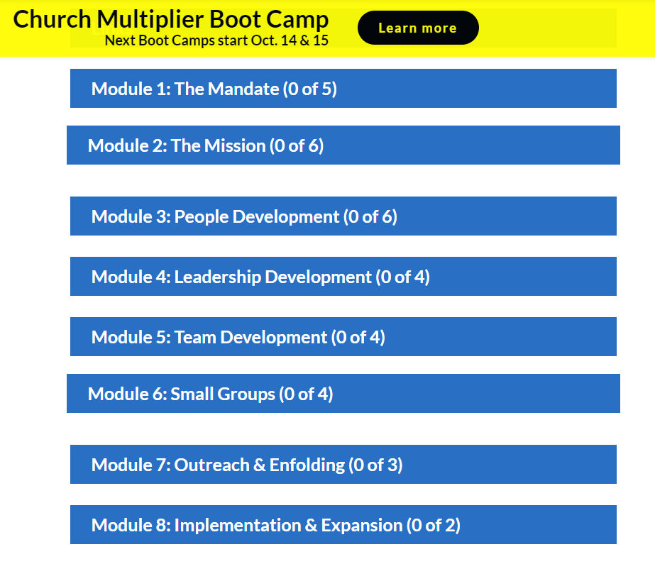
Road Map

Slide 42
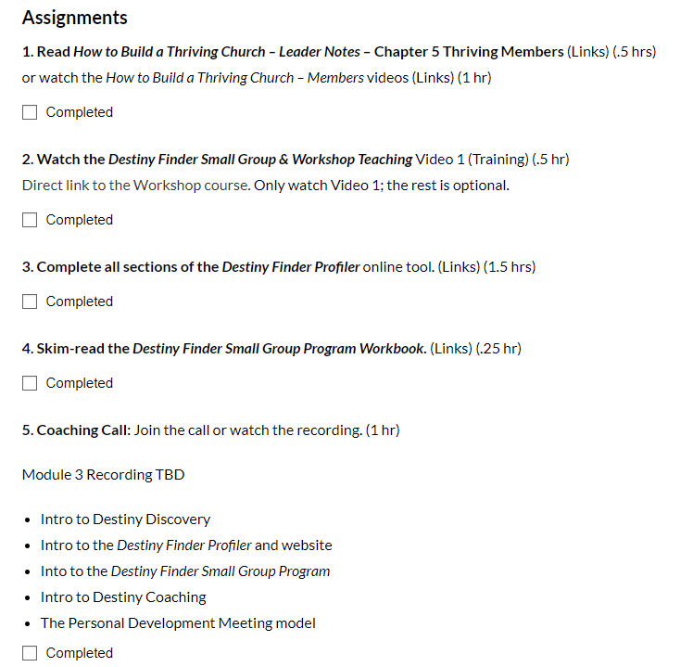
Module Assignments

Slide 43
Boot Camp Starts April 18
This is an amazing 12-week training experience.
Boot Camp Training Sessions:
Tues April 18-July 6 from 9-10:30 AM Pacific Time
Group Coaching and Support Call (Optional)
Thursdays from 9-10 AM Pacific Time
More info and sign up: https://pastorscoach.com/

Slide 44
Boot Camp Pricing
This is the best of the best of our material and resources! Includes:
12-week program with weekly live training sessions, courses, Destiny Finder Small Group Program, lifetime access to the material, live support, and more.
Only offered live once. It will be recorded and included in other programs.
Total value: Over $5000.
Boot Camp Investment: $1997 or 3 x $749 (3 monthly payments).
Go to pastorscoach.com, select the option, complete the order.
Special Offer for Webinar participants: If you sign up by April 10 you will receive two free personal one-on-one coaching calls (reg. $400).
Special Offer expires Mon April 10 at midnight! ***

Slide 45
Testimonies
There is nothing else quite like this available anywhere!
"Pastor's Coach shaped our journey as we prepared to plant a church.“
-- Banning Liebscher, Director, Jesus Culture Church Sacramento CA USA
“I haven’t had so much fun in ministry since I was in my twenties!” -- Paul Berteig, pastor of Genesis Community Church in Prince George Canada: https://pastorscoach.com/video/boot-camp-testimony-paul-berteig/
“20 years in ministry, seven as a Senior Pastor… But I have NEVER come across anything like Pastor’s Coach. I’m only one month into their 2 year Q2Q Church Growth Track, but I am fast becoming convinced that this is THE BEST MATERIAL and MOST EXTRAORDINARY COACHING that I have EVER come across. Do yourself a favour - connect with Pastors Coach - it’ll be one of the best and most defining decisions of your ministry.“ -- Luke Harris, Senior Pastor, Empower Church - The Shire, Cronulla, Australia.

Slide 46
Contact
Please contact us with any questions or meeting requests:
We can do a zoom or Skype meeting with your team or elder board to talk about how this will work for your church or ministry.
Call us at +1 (916) 467-9934
Email us at info@pastorscoach.com
Destiny Finder Small Group Program: https://destinyfinder.com/smallgroups/

Slide 47
Boot Camp Starts April 18
This is an amazing 12-week training experience.
Boot Camp Training Sessions:
Tues April 18-July 6 from 9-10:30 AM Pacific Time
Group Coaching and Support Call (Optional)
Thursdays from 9-10 AM Pacific Time
More info and sign up: https://pastorscoach.com/

Slide 48
Boot Camp Pricing
This is the best of the best of our material and resources! Includes:
12-week program with weekly live training sessions, courses, Destiny Finder Small Group Program, lifetime access to the material, live support, and more.
Only offered live once. It will be recorded and included in other programs.
Total value: Over $5000.
Boot Camp Investment: $1997 or 3 x $749 (3 monthly payments).
Go to pastorscoach.com, select the option, complete the order.
Special Offer for Webinar participants: If you sign up by April 10 you will receive two free personal one-on-one coaching calls (reg. $400).
Special Offer expires Mon April 10 at midnight! ***

Slide 49
Questions
Why does it take 2-3 years to fully implement? This is a big shift, it takes a lot of time to change the culture in a church.
Can I do it on my own? Yes but working with a coach will greatly accelerate your progress.
Will it really work in my situation (culture, age group, rich/poor, etc.)? Yes, we work with all types of churches around the world.

Slide 50
Conclusion
A copy of these slides will be sent by email.
A recording of this webinar will be available.
Questions: Call us at +1-916-671-0146 (mobile or WhatsApp).
Your future self is begging you to get on board!

Slide 51
Q&A
Ask please!

Slide 52
More Testimonies
“Michael and Glen, I want to express my huge appreciation to you for the Pastor's Coach program. I want to let you know that I get it.
It’s not a program. It’s a total paradigm shift for ministry, out of traditionalism and into the leadership model and church building strategy that Jesus intended. I get the big picture.
The moment I heard that Michael spent 20+ hours per week in face-to-face mentoring, my life was changed forever and there’s no going back. When I understood that personal leadership development and small group team ministry were higher priority than the weekend service, my life changed forever. No going back. Thank you both!”
-- Mike Harding, Senior Pastor, Love Gospel Church, Apache Junction, Arizona, USA (Boot Camp March 2018)

Slide 53


Slide 54
